Slide 1

Daily market Report
02 Jul 25

Slide 2
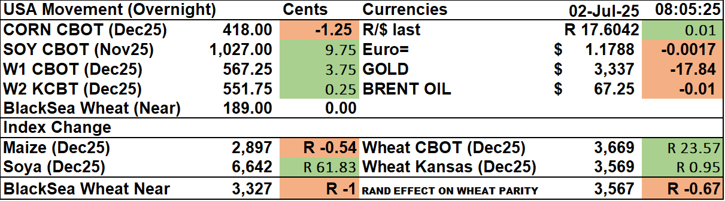

Parity Movements (implied price moves)
Data, news and graphs reproduced using Refinitiv. Although everything has been done to ensure the accuracy of the report NeXgro (Pty) Ltd cannot be held responsible for any losses incurred as a result of the use of the information contained in the report

Slide 3
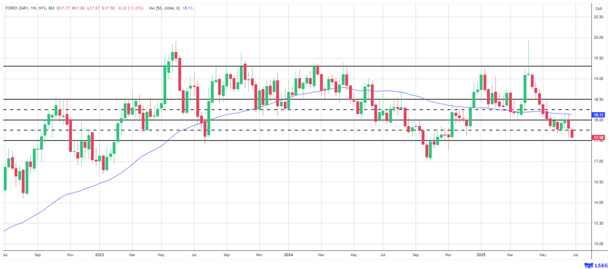
South African Rand (ZAR)
USD/ZAR Weekly: Medium-term ZAR bullish < R18.15
Data, news and graphs reproduced using Refinitiv. Although everything has been done to ensure the accuracy of the report NeXgro (Pty) Ltd cannot be held responsible for any losses incurred as a result of the use of the information contained in the report

Slide 4
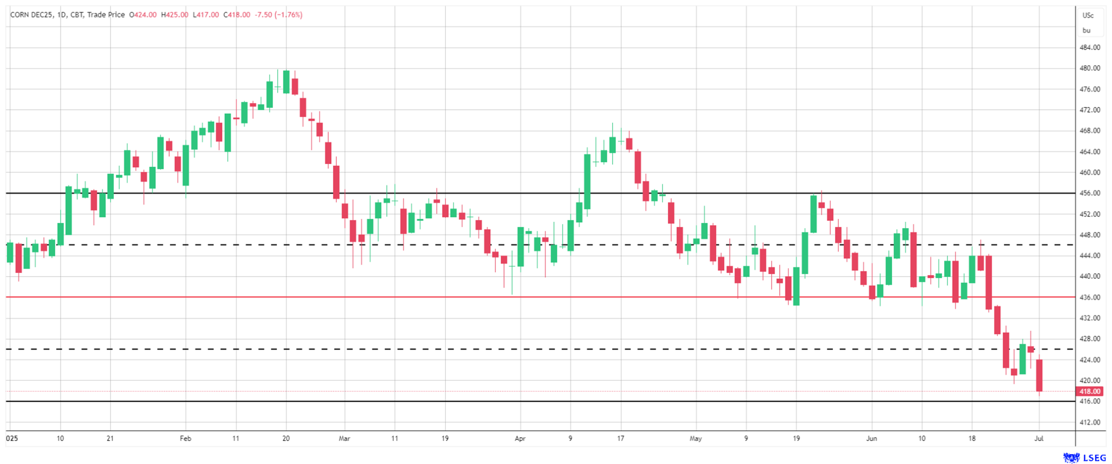
USA Corn
Dec25 Daily: Contract status bearish < $4.36
Data, news and graphs reproduced using Refinitiv. Although everything has been done to ensure the accuracy of the report NeXgro (Pty) Ltd cannot be held responsible for any losses incurred as a result of the use of the information contained in the report

Slide 5
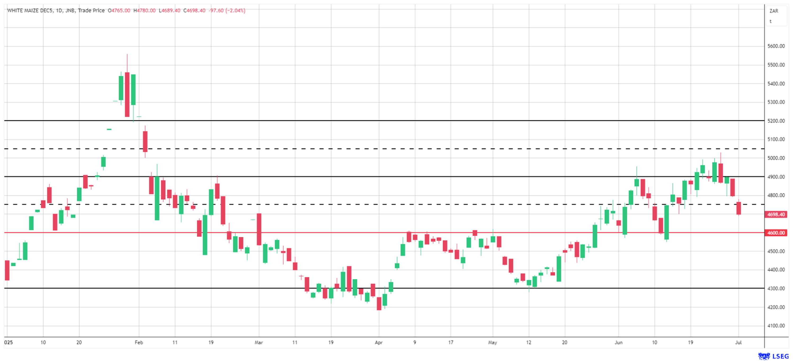
White Maize
Dec25 Daily: Contract status bullish > R4600
Data, news and graphs reproduced using Refinitiv. Although everything has been done to ensure the accuracy of the report NeXgro (Pty) Ltd cannot be held responsible for any losses incurred as a result of the use of the information contained in the report

Slide 6
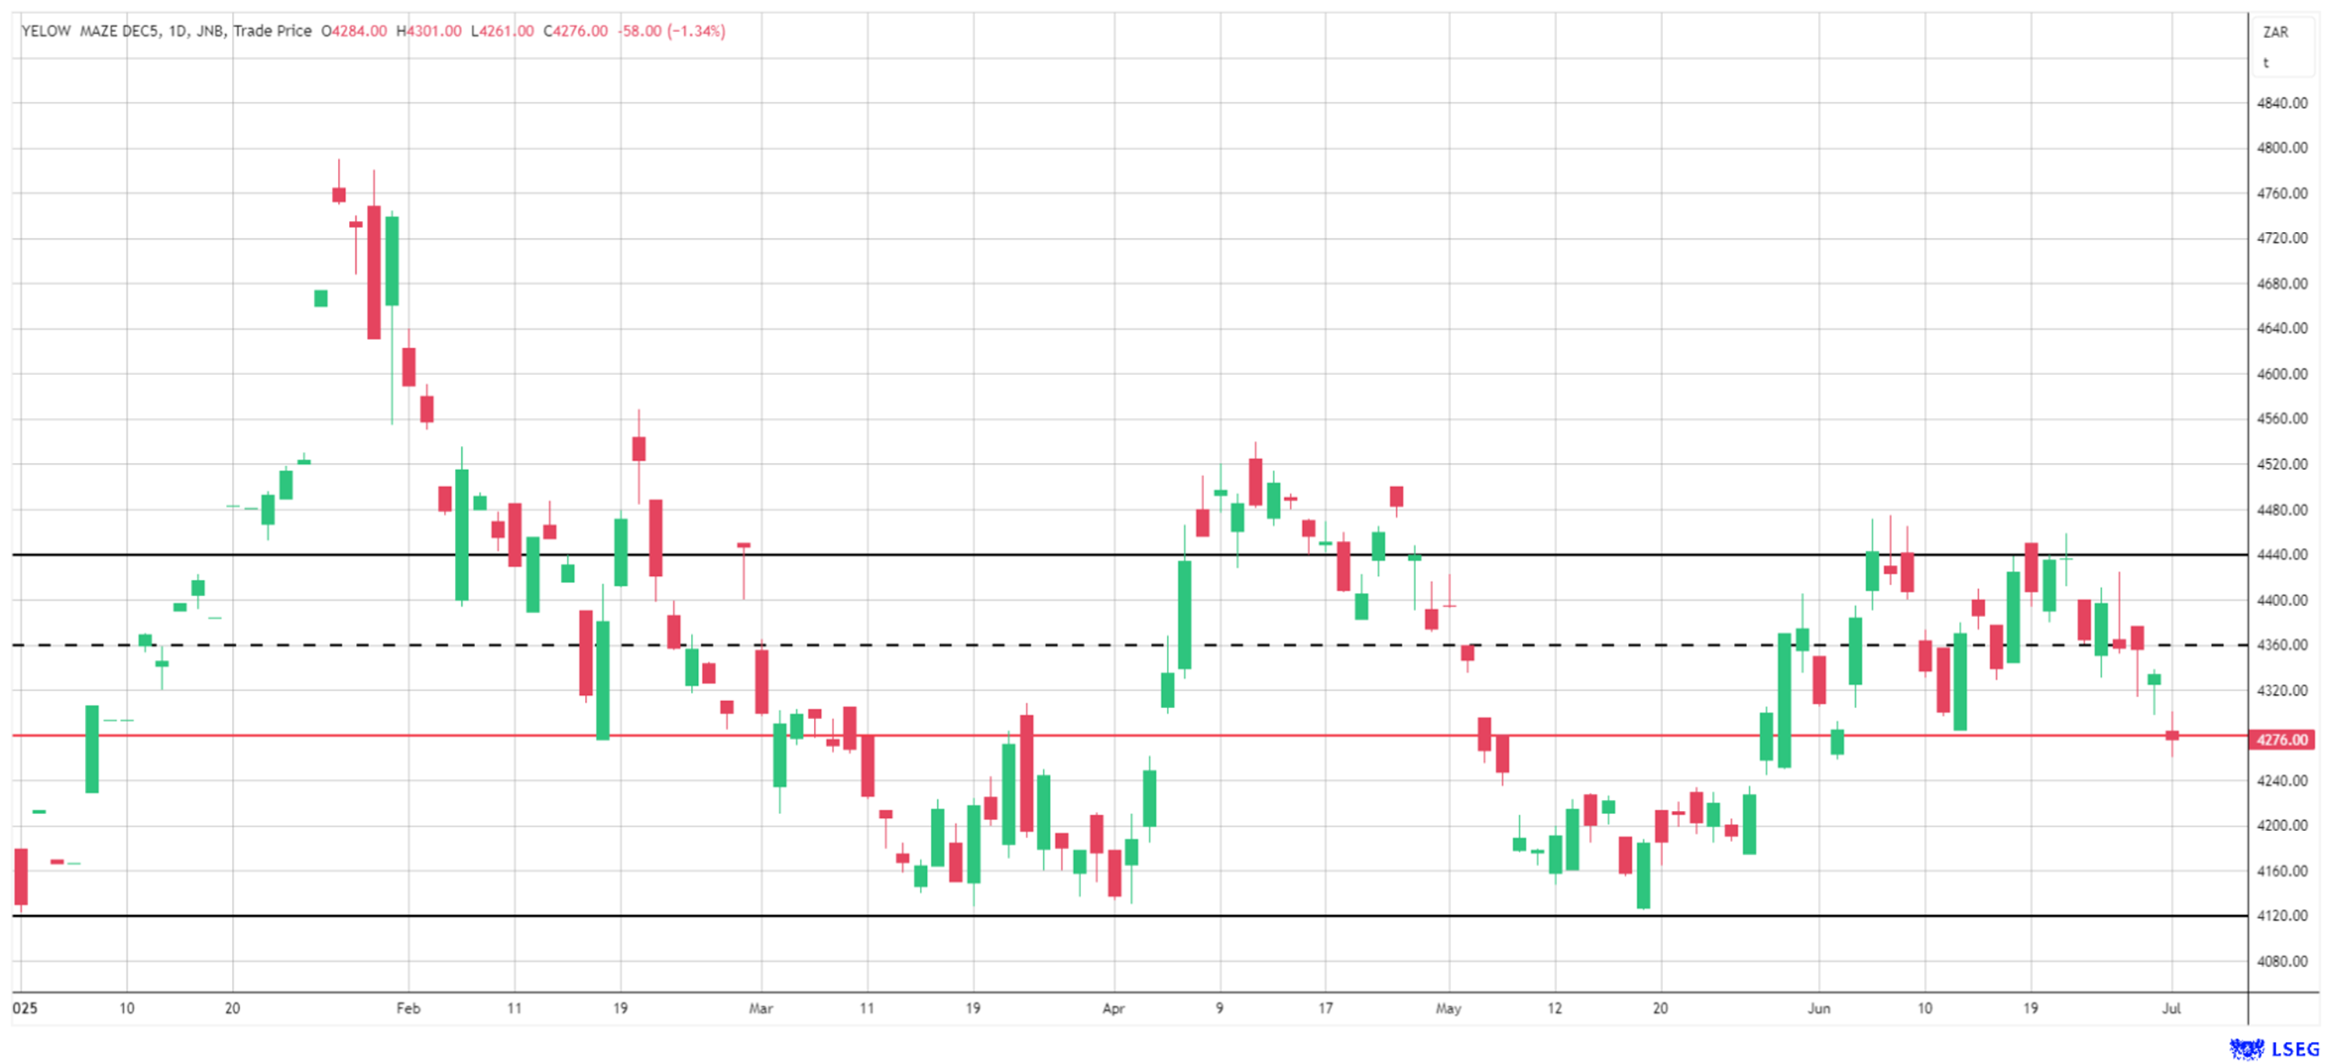
Yellow Maize
Dec25 Daily: Contract status bearish < R4280
Data, news and graphs reproduced using Refinitiv. Although everything has been done to ensure the accuracy of the report NeXgro (Pty) Ltd cannot be held responsible for any losses incurred as a result of the use of the information contained in the report

Slide 7
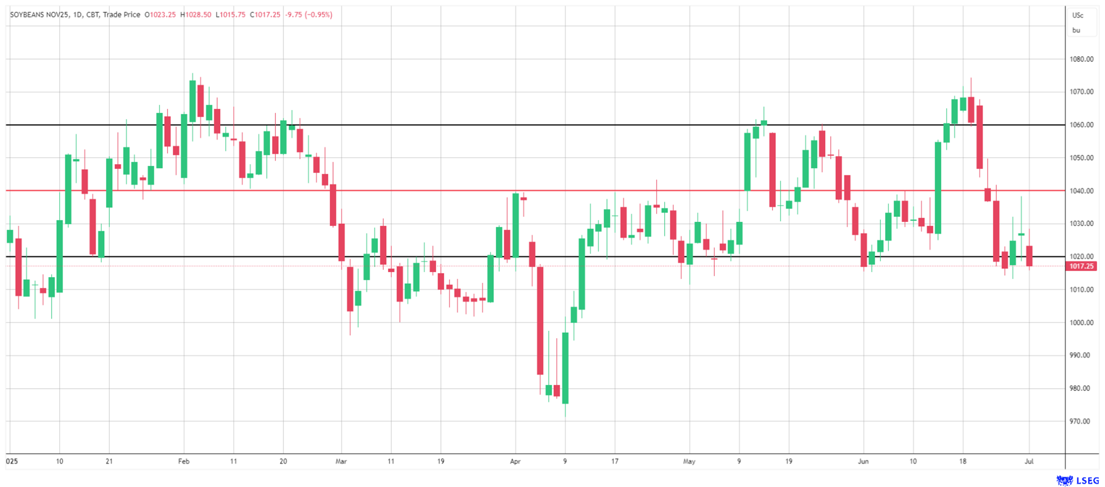
USA Soya
Nov25 Daily: Contract status bearish < $10.40
Data, news and graphs reproduced using Refinitiv. Although everything has been done to ensure the accuracy of the report NeXgro (Pty) Ltd cannot be held responsible for any losses incurred as a result of the use of the information contained in the report

Slide 8
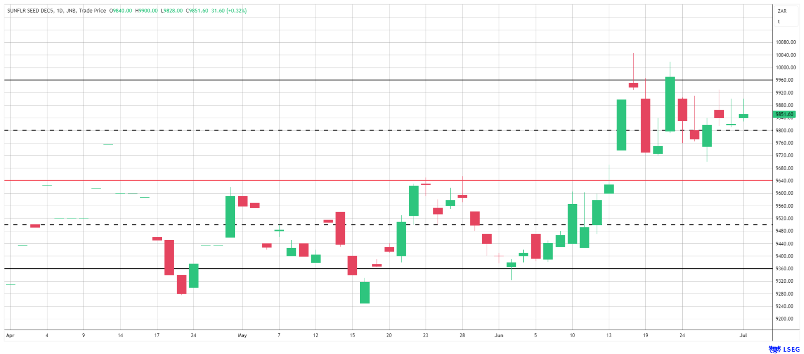
Suns
Dec25 Daily: Contract status bullish > R9640
Data, news and graphs reproduced using Refinitiv. Although everything has been done to ensure the accuracy of the report NeXgro (Pty) Ltd cannot be held responsible for any losses incurred as a result of the use of the information contained in the report

Slide 9
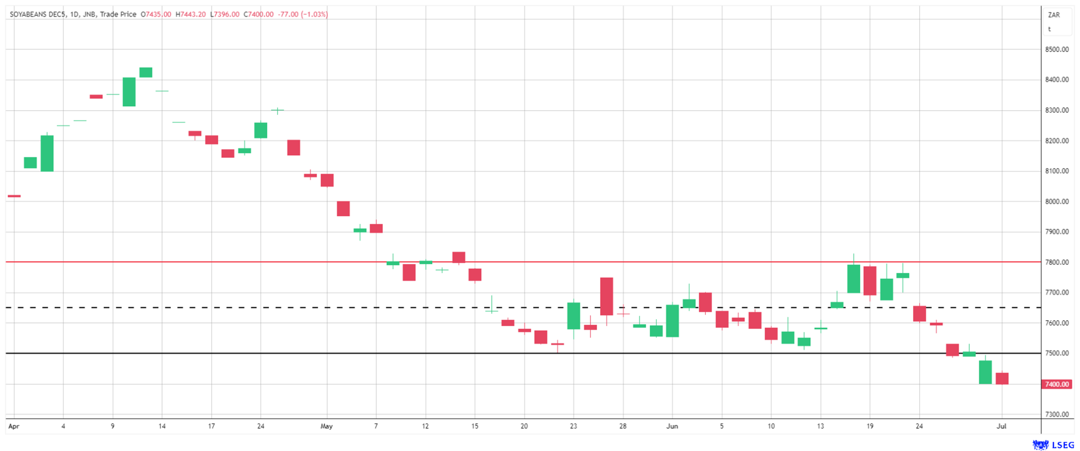
SA Soya
Dec25 Daily: Contract status very bearish < R7800
Data, news and graphs reproduced using Refinitiv. Although everything has been done to ensure the accuracy of the report NeXgro (Pty) Ltd cannot be held responsible for any losses incurred as a result of the use of the information contained in the report

Slide 10
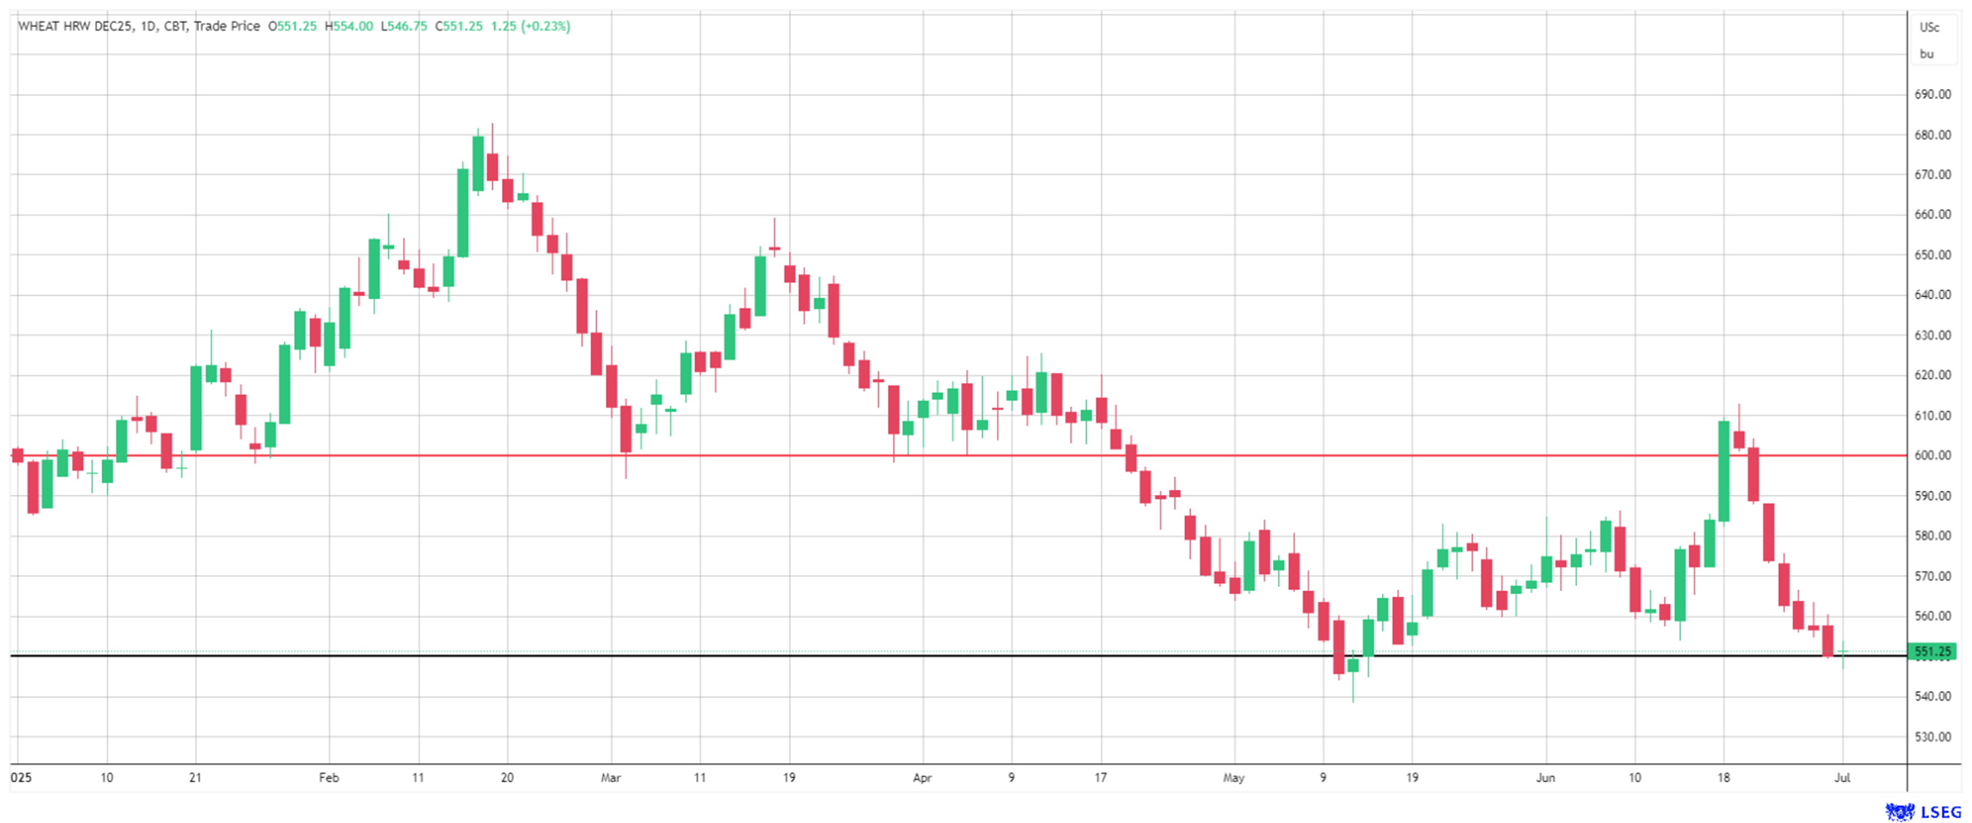
US KANSAS Wheat
Dec25 Daily: Contract status very bearish <$6.00
Data, news and graphs reproduced using Refinitiv. Although everything has been done to ensure the accuracy of the report NeXgro (Pty) Ltd cannot be held responsible for any losses incurred as a result of the use of the information contained in the report

Slide 11
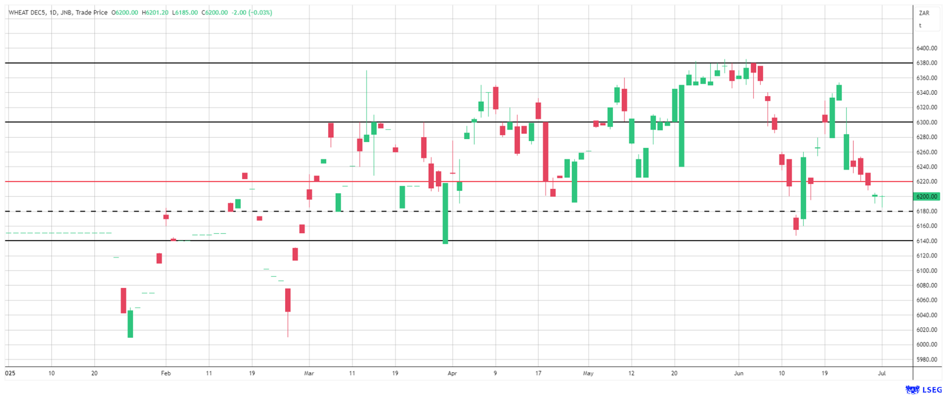
SA Wheat
Dec25 Daily: Contract status bearish < R6220
Data, news and graphs reproduced using Refinitiv. Although everything has been done to ensure the accuracy of the report NeXgro (Pty) Ltd cannot be held responsible for any losses incurred as a result of the use of the information contained in the report

